Slide 1
User defined data types

Slide 2
Introduction
The data types that are defined by the user are called the derived data-type or user-defined derived data type.
These types include:
Class
Structure
Union
Enumeration
Typedef defined DataType

Slide 3
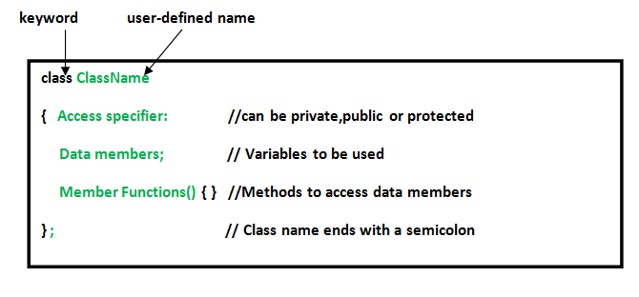
User defined data type contd.
Class: The building block of C++ that leads to Object-Oriented programming is a Class. It is a user-defined data type, which holds its own data members and member functions, which can be accessed and used by creating an instance of that class. A class is like a blueprint for an object. Syntax

Slide 4
User defined data type contd.
Enumeration: Enumeration (or enum) is a user defined data type in C. It is mainly used to assign names to integral constants, the names make a program easy to read and maintain. Syntax:
enum State {Working = 1, Failed = 0};

Slide 5
User defined data type contd.
Typedef : C++ allows you to define explicitly new data type names by using the keyword typedef. Using typedef does not actually create a new data class, rather it defines a name for an existing type. This can increase the portability(the ability of a program to be used across different types of machines; i.e., mini, mainframe, micro, etc; without much changes into the code)of a program as only the typedef statements would have to be changed. Using typedef one can also aid in self-documenting code by allowing descriptive names for the standard data types.

